Slide 1


MMID: Introduction to Data Fitting

Slide 2
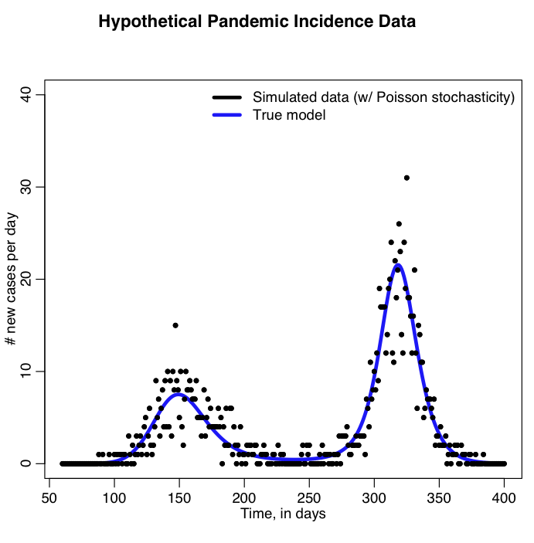
http://sherrytowers.com/wp-content/uploads/2014/07/sim_sir_harm.png

Slide 3
Fitting models to data: Why?
To mimic the system you wish to model
Once you can “replicate reality” then you can use the model for prediction
Parameter estimates
Clinical trials and other studies
Existing literature
Guess?
Fit models to data to estimate parameter values

Slide 4
How?
Case 1
Know all parameter values
Validation
Visually
Known Goodness of fit metrics
Discuss later
Case 2
Unknown parameter values
Obtain best estimates for parameters conditional on the data

Slide 5
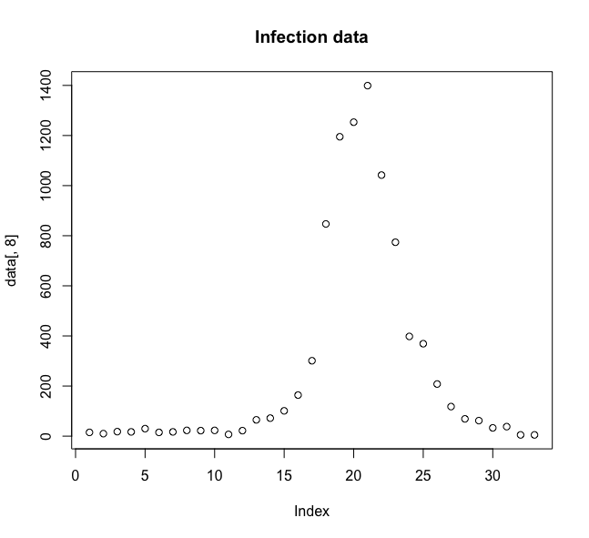
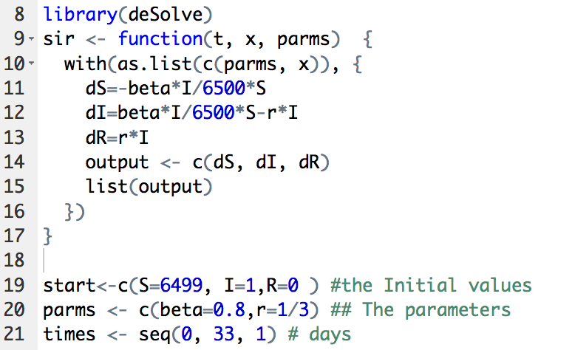
Case 1

Slide 6
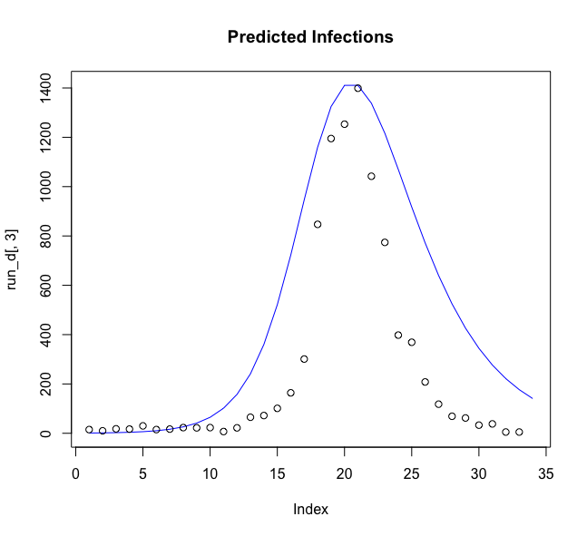
Case 1

Slide 7
Case 2
Least squares Approach
What values for these parameters will minimise the sum of the squares of the model errors (difference between model predictions and data at each time point)
Likelihood Approach
Maximum likelihood estimation is a method that determines values for the parameters of a model. The parameter values are found such that they maximise the likelihood that the process described by the model produced the data that were actually observed.
What are the values of the parameters that lead to the most likely probability of observing the data?

Slide 8
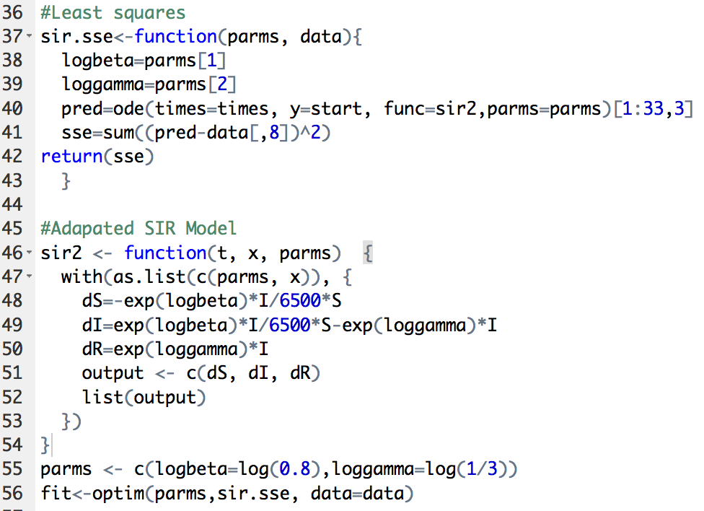
Least Squares

Slide 9
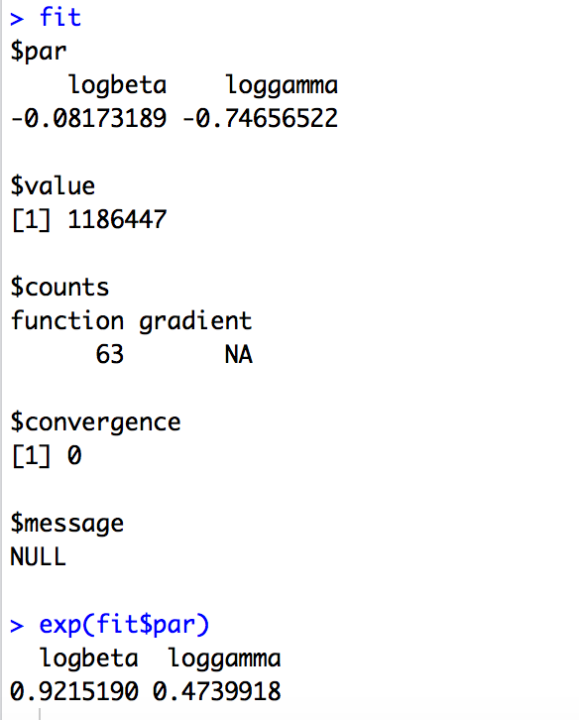
Least squares

Slide 10
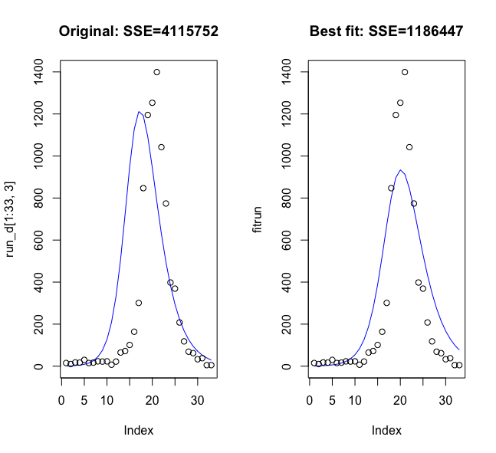
Least Squares

Slide 11
Least Squares
Advantages
Easy to implement
Intuitive
Optimise several parameters with no additional effort
Disadvantages
Every residual is equally weighted
Undue effect of large residuals
Fit to log/square root data
No account of probability structure of data
No confidence intervals

Slide 12
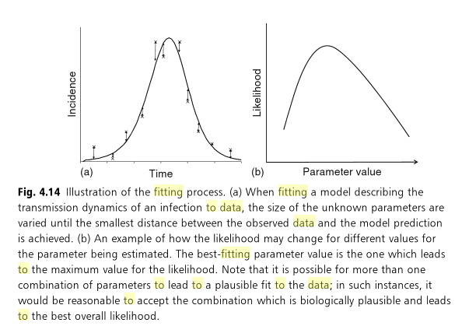
Maximum Likelihood Method

Slide 13
Likelihood theory
Advantages
Efficiency
A deep and general theory
Sound theoretical basis for confidence intervals and model selection
Fidelity to model
Disadvantage
Can be very complicated to define

Slide 14
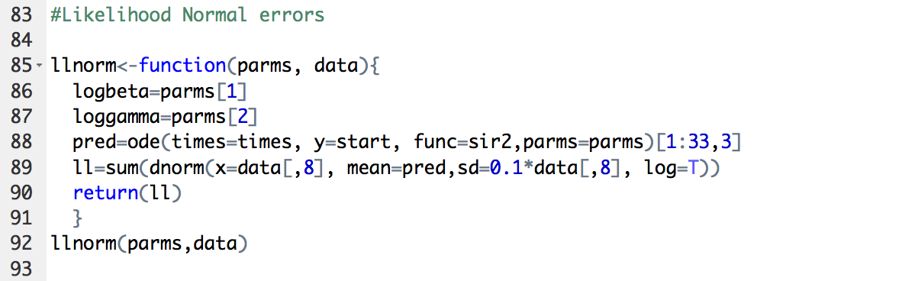
SIR Model
Suppose you believe your model errors to be normally distributed

Slide 15
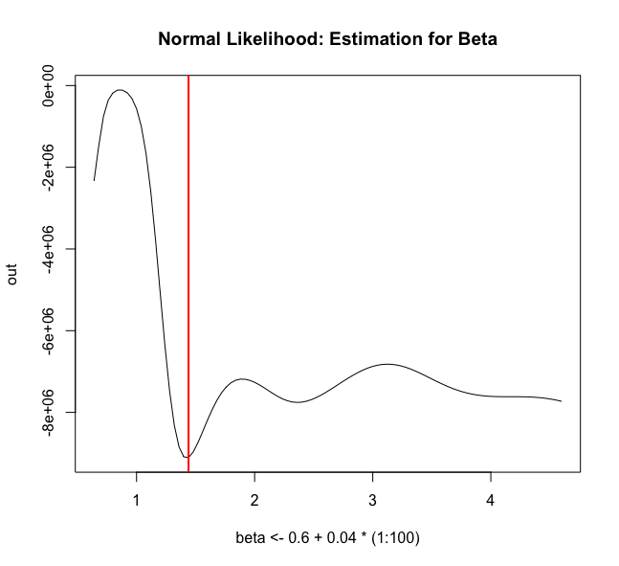
SIR Model
β=1.44

Slide 16
SIR Model
Data represent Poisson samples with expectation pI, where p is the reporting proportion

Slide 17
SIR Model

Slide 18
SIR Model

Slide 19
SIR Model

Slide 20
Validation & Practical Issues
Improve routine by transforming bounded variables
Divide your data into a testing and training set
Use goodness of fit statistics
Root mean square error
Proportion captured in confidence interval
R²
Non parallelizable

Slide 21
Likelihood vs Least Squares
Likelihood can give
Probability structure
Efficiency
Both suffer from IDENTIFIABILITY
Several parameter sets optimise likelihood/SSE
Plausible for disease
Initial parameter bias
Local Optima
Run from several starting points
Find better optimiser!!

Slide 22
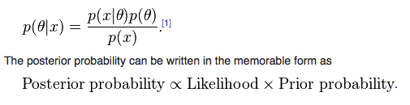
Bayesian Methods
Posterior probability distribution
probability distribution of an unknown quantity, treated as a random variable, conditional on the evidence obtained from an experiment or survey

Slide 23
Gibbs Sampling
Given an Multivariate distn, it is easier to sample from a conditional distn than to marginalise by integrating over the whole distribution
Samples approximate joint distn of all variables
Approximate marginals by assessing subsets

Slide 24
Monte Carlo Markov chain
Class of algorithms for sampling from any distribution through constructing a Markov chain with the desired distribution as the equilibrium distribution.
Metropolis Algorithm
Metropolis Hastings Algorithm

Slide 25
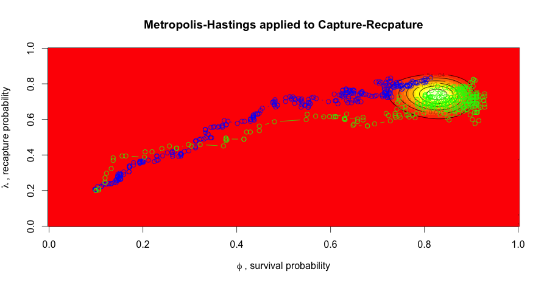
Monte Carlo Markov chain

Slide 26
Problems
complex mathematical model calibration is uncommon
most formal methods (including distance-based and likelihood-based measures) require that models are run many times.
This poses a considerable problem for complex models as they may require many minutes or even hours for a single scenario.
Model simplification, although desirable, is not appropriate if a complex model is required to satisfactorily address the research question and it increases the probability of model inadequacy.
As the number of model parameters increases, the number of runs required for an adequate exploration of the parameter space increases rapidly.
Robust fitting and uncertainty analysis of complex models with dozens of parameters is often impossible, even with increasing computer power and advances in parallelisation.

Slide 27
Other Bayesian Methods
Approximate Bayesian Computation
an analytical formula might be elusive or the likelihood function might be computationally very costly to evaluate.
bypass the evaluation of the likelihood function
Smith RL, Gröhn YT. Use of Approximate Bayesian Computation to Assess and Fit Models of Mycobacterium leprae to Predict Outcomes of the Brazilian Control Program. Hsiao CK, ed. PLoS ONE. 2015;10(6):e0129535.

Slide 28
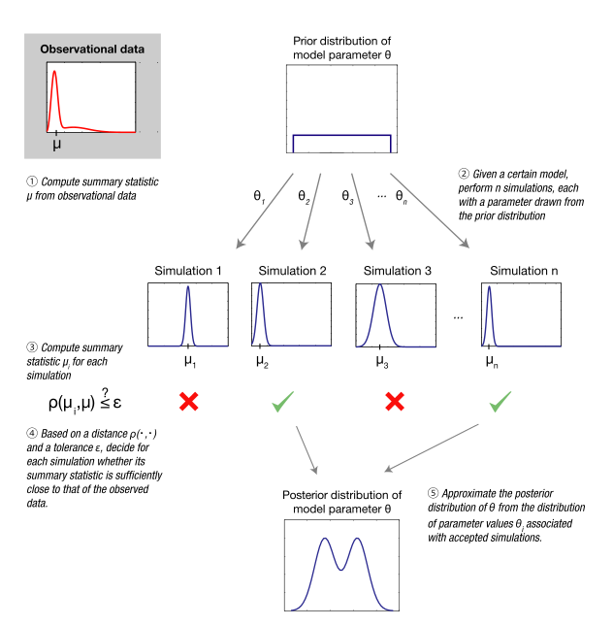
Other Bayesian Methods

